Slide 1

Mobile Workshop
Radu Nicoara & Julian Steiner
julian.steiner@progress.com @steiner_j
2019-10-29
Notes:
This is an overview presentation of the Progress vision and future direction. It discusses Progress’ value proposition and ties our current products to our company vision. Use slides from this presentation to tailor your own pitch about why Progress is a vendor of choice given our unique vision and place in the market. It can be used to facilitate discussions with the customer or prospect on current state and future business direction.

Slide 2
play.nativescript.org Get your phone out
Go to Google Play or AppStore
Install
“NativeScript Playground”
“NativeScript Preview”

Slide 3
Workshop materials:
tiny.cc/6nvbfz

Slide 4

Radu Nicoara
Consultant / Developer
Using OpenEdge for about 5 years
Several years of experience in Angular, NativeScript and node.js
Developed the SmartComponent Library for Angular and NativeScript
Supports customers, offers consultation for web and mobile architecture and provides trainings and mentoring services

Slide 5

Julian Steiner
Sr. Solution Engineer julian.steiner@progress.com
@steiner_j

Slide 6





<markup/>
{ CSS }
{ CSS }

Slide 7



Architecture Choices
or
or
or

Slide 8

Notes:
Obviously, you might think: I’ve heard that before…
Let me explain the key differences to the most prevalent mobile development platforms

Slide 9



Hybrid
Native UI
WebView

Slide 10
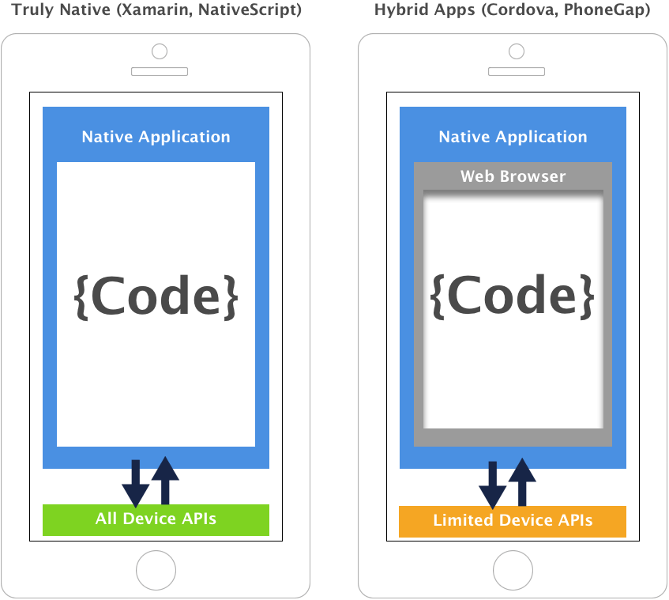

Slide 11
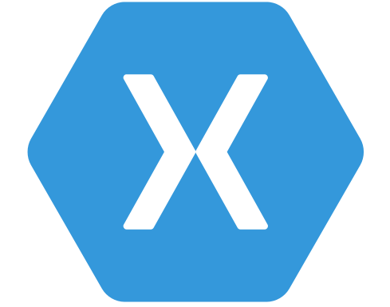
JavaScript
C#

Slide 12

100% Access to
Native APIs
Wrapper
modules

Slide 13

Native App
Web App

Slide 14
Application Framework
NativeScript Core Modules
(data-binding, navigation, XML)
Angular
Vue
Cross Platform Abstraction
NativeScript Core Modules
(UI Views and Layouts)
Plugins
Native API Access
NativeScript Runtimes
Native Code
Android
IOS

Slide 15
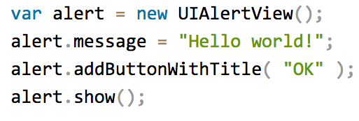
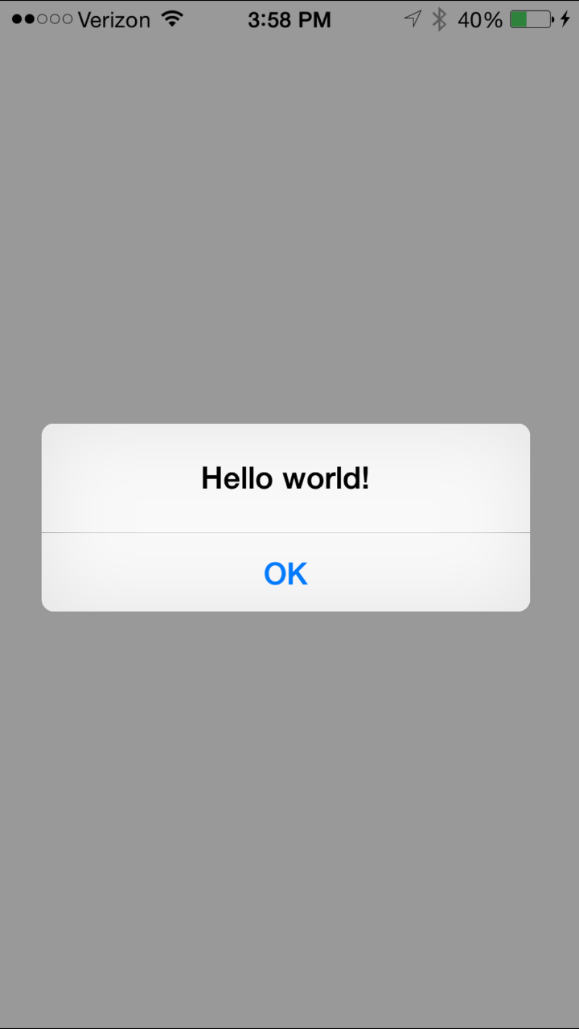
100% access to Android and iOS APIs
Notes:
Npm, CocoaPods, Android Arsenal

Slide 16
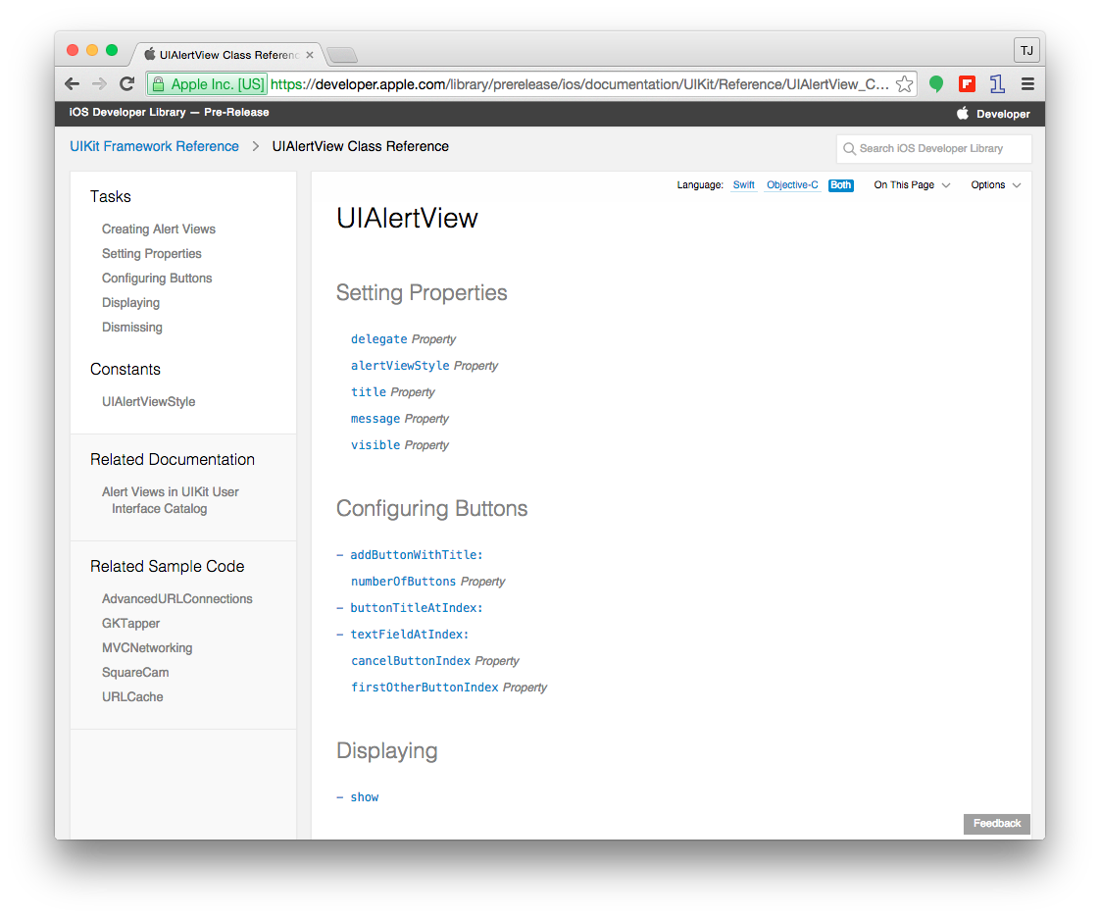

Slide 17

How does this work?

Slide 18
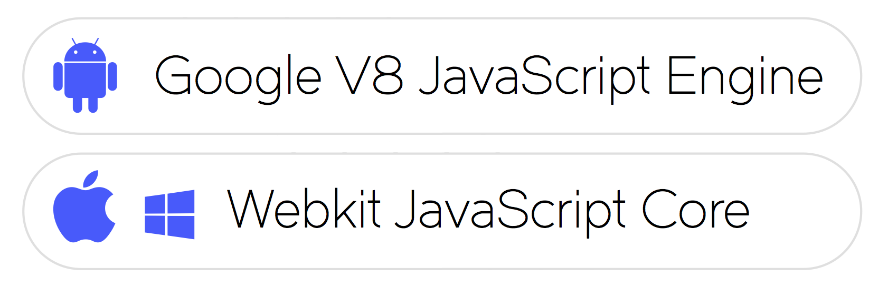
Platform Approaches
Notes:
This is going to be like trying to explain a magic trick, so I hope it won’t take the magic out of it.
NativeScript is not just a set of libraries, but more of a Runtime that enables you to call native APIs: for Android, iOS and Windows Universal
It uses a pre-packaged JavaScript Virtual Machine. To be precise:
•For Android it is – Google’s v8 JavaScript Engine,
•For iOS and Windows Phone it is – WebKit’s JavaScriptCore

Slide 19
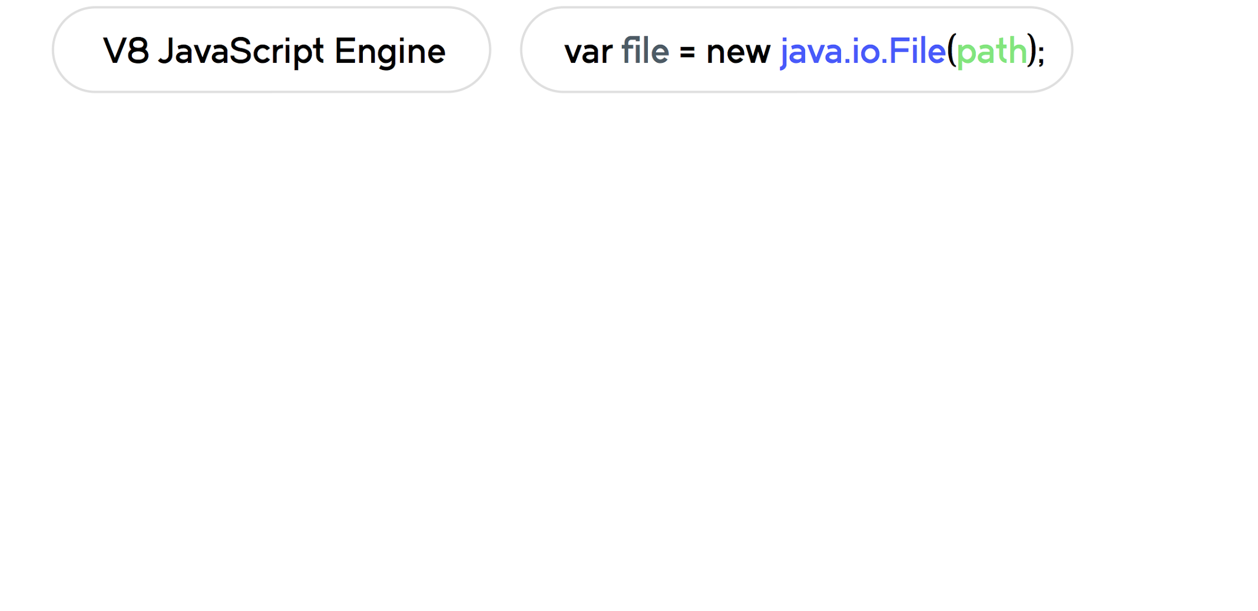
Calling Android API
Notes:
var file = new java.io.File(path);
which calls Android API to create a file object.
The JavaScript Virtual Machine or in this case Google’s v8 JavaScript Engine, evaluates the code.

Slide 20
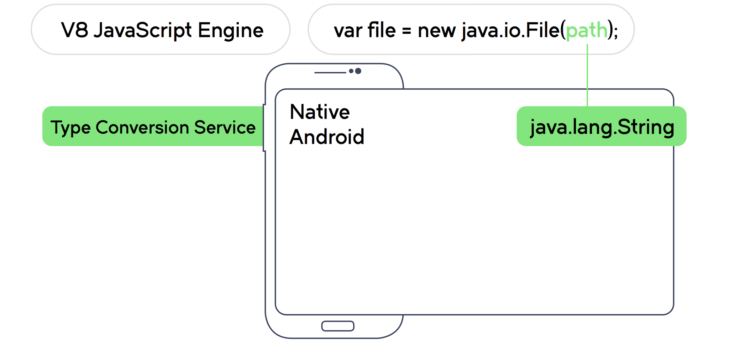
Calling Android API
Notes:
The Type Conversion Service converts the path value, from the JavaScript String to the native Java String object.

Slide 21
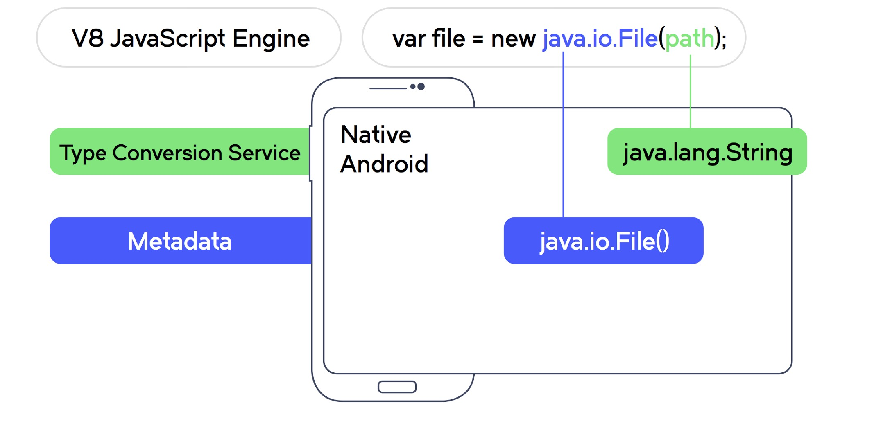
Calling Android API
Notes:
Metadata will lookup the Android API and determine the corresponding native method to call
and as a result finding the native constructor for the File class.

Slide 22
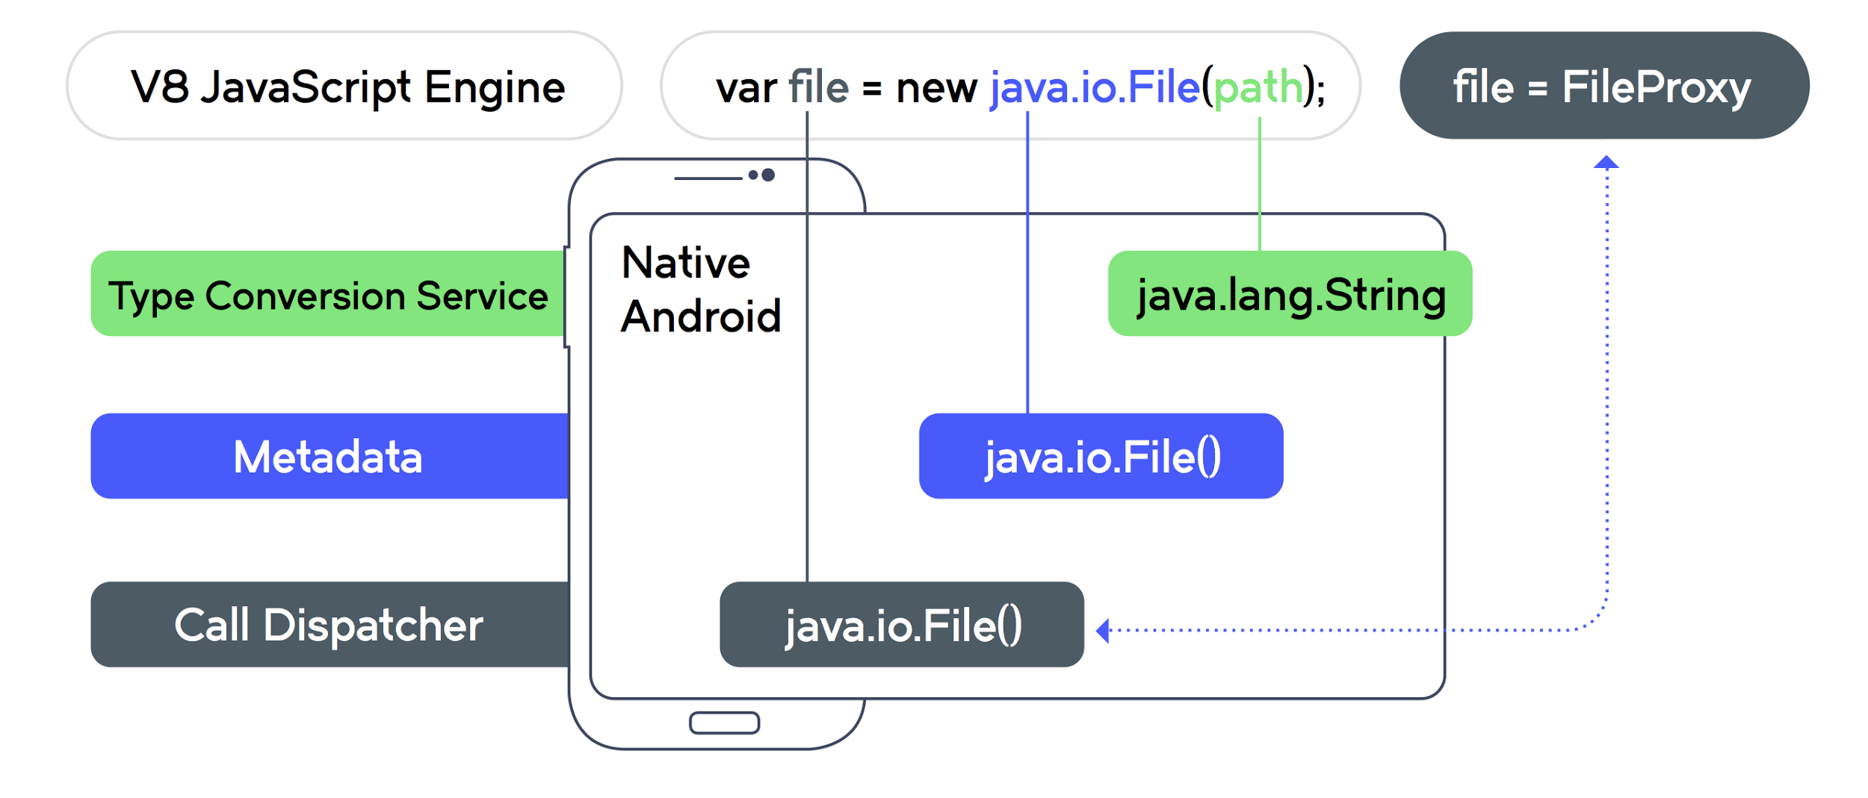
Calling Android API
Notes:
The call dispatcher executes the call with a dual result:
•On the Android Side: we get a new instance of the native File class
•On the NativeScript Side: we get a custom JavaScript Object serving as a proxy to the native Android’s object
When a method is called on this proxy it is delegated to the underlying native object.
<Before the next slide>
This is the foundation of the NativeScript framework.
The next logical step was to create a platform agnostic abstraction layer.
It is really great that you can access native APIs straight form JavaScript.
But I can hear you think. … this still doesn’t solve the problem of me having to learn all those Platform APIs.
But this is just the foundation of the NativeScript framework.

Slide 23
Application Framework
NativeScript Core Modules
(data-binding, navigation, XML)
Angular
Vue
Cross Platform Abstraction
NativeScript Core Modules
(UI Views and Layouts)
Plugins
Native API Access
NativeScript Runtimes
Native Code
Android
IOS

Slide 24
One code base
Two platforms

Slide 25
Core Modules
(Non-UI)
File System
Resources
Local Storage
HTTP
Timers
Etc.

Slide 26
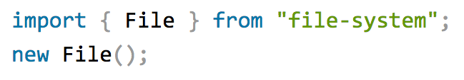

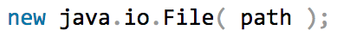

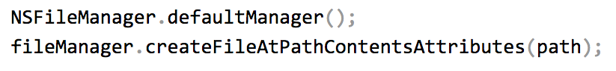
Example: NativeScript file module

Slide 27

margin-right: -100px !important;

Slide 28
Core Modules
(UI)
Define with
XML
Style with
CSS
<StackLayout (tap)="do()">
<Label [text]="msg"></Label>
</StackLayout>
.code-char {
font-size: 50;
margin: 4;
}

Slide 29
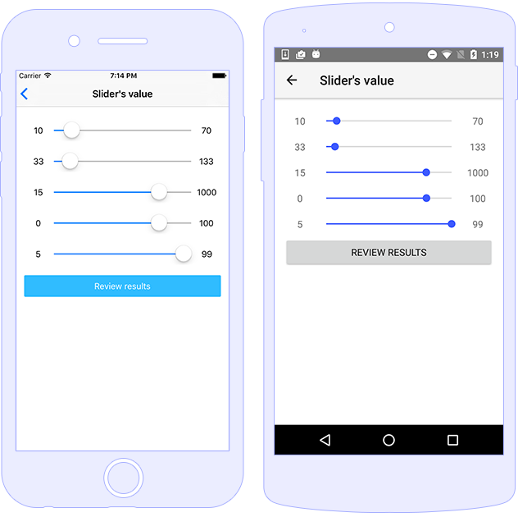
Native UI Widgets
<Slider value="10"
minValue="0"
maxValue="100">
</Slider>

Slide 30
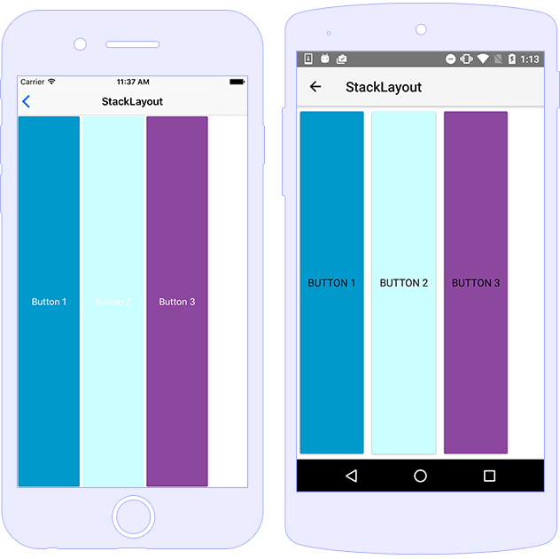
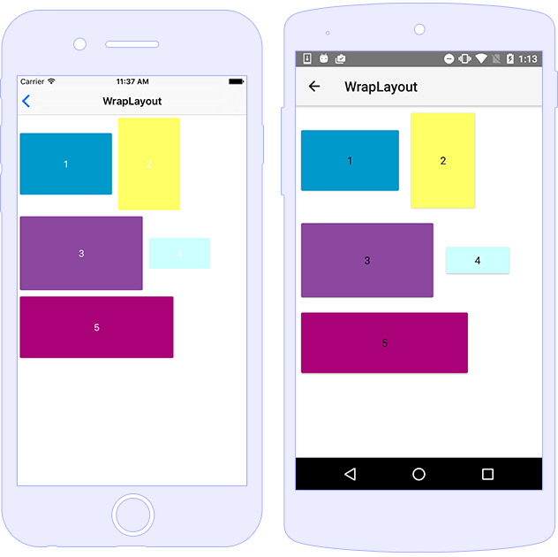
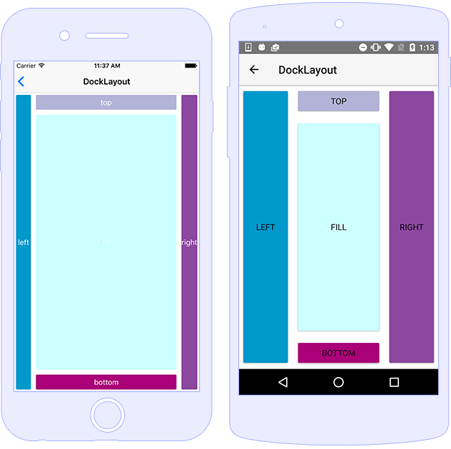
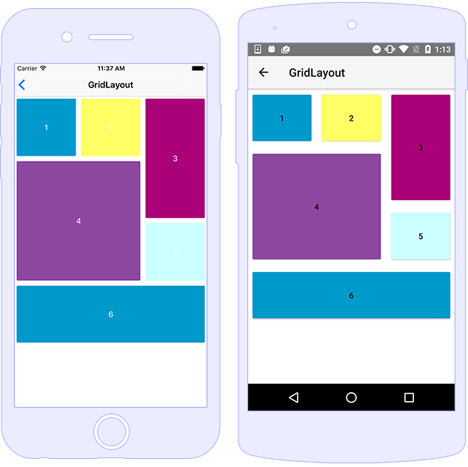
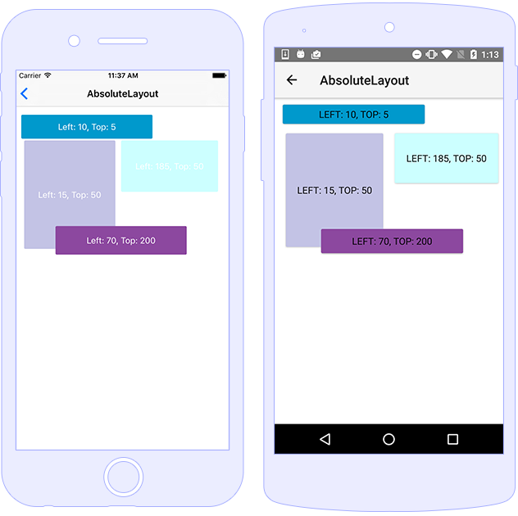
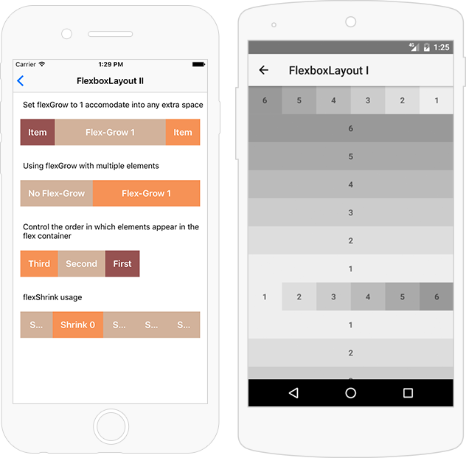
Layouts
<Stack/>
<Wrap/>
<Flexbox/>
<Grid/>
<Absolute/>
<Dock/>

Slide 31
Application Framework
NativeScript Core Modules
(data-binding, navigation, XML)
Angular
Vue
Cross Platform Abstraction
NativeScript Core Modules
(UI Views and Layouts)
Plugins
Native API Access
NativeScript Runtimes
Native Code
Android
IOS

Slide 32
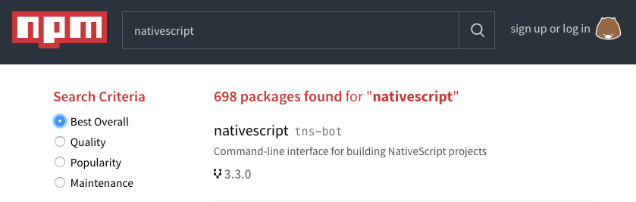

Plugin Ecosystem
market.nativescript.org
Notes:
Third party
Android/iOS libraries work out-of-the-box

Slide 33
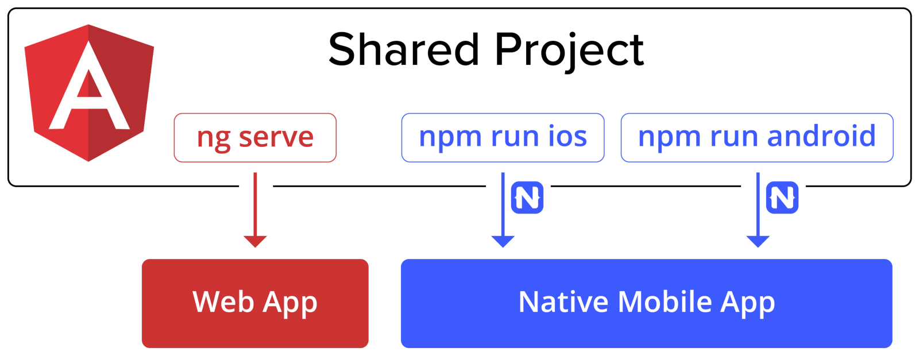

Slide 34


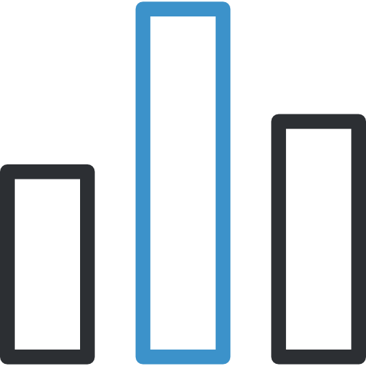



Why NativeScript?
Web Skill Reuse
100% API
Access
Native Performance
Zero Day
Support
Free and Open
Source
Community
Icons by Gregor Cresnar

Slide 35




Get Started
Get Serious
Play
Docs
CLI
SideKick

Slide 36
Hands-on 1 - Warm up with NativeScript

Slide 37



+
Front-to-back productivity for enterprise mobile projects
Notes:
In summary, value of using Progress Mobility:
Write once, run natively on both iOS and Android devices using the skills you already have
Gain 75% faster time to market
Realize 60% lower cost of ownership
Achieve simple, fast and secure access to enterprise

Slide 38
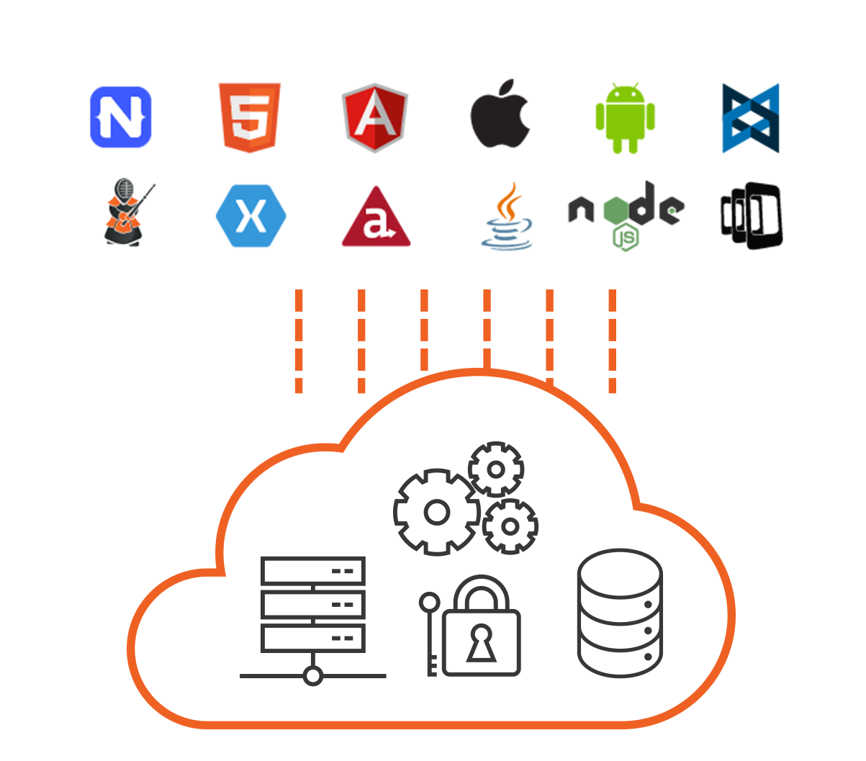

Kinvey Backend as a Service
Instantly available, complete serverless app platform
Self-service by design. Built by developers for developers
Developers can choose end-to-end JavaScript or any frontend tools
Designed for demanding regulatory and security workloads including HIPAA
Open standards architecture provides cloud flexibility
38
© 2017 Progress Software Corporation and/or its subsidiaries or affiliates. All rights reserved.
Notes:
In terms of our cognitive cloud capabilities, let’s start with Backend as a Service
Progress Kinvey provides ---- read / paraphrase the bold title line
Introduce the key capabilities / differentiators listed in the slide

Slide 39
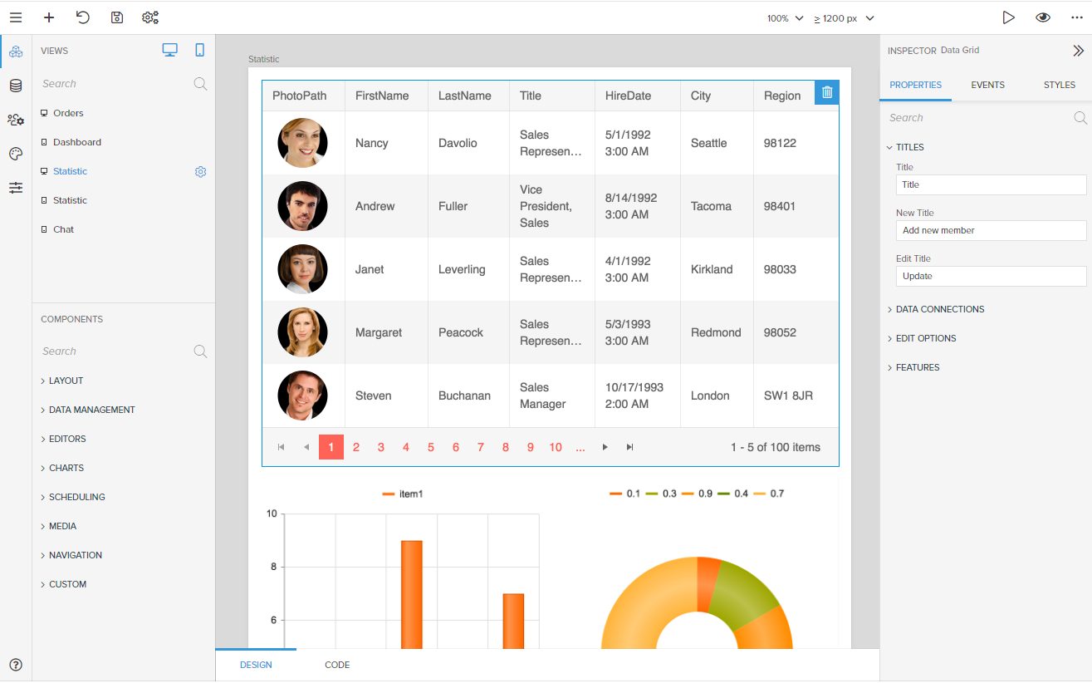
Kinvey Studio
A complete platform for rapidly developing modern, complex web and mobile apps bound to data
High control control over code
+

Slide 40


